Slide 1

Library Database Analysis

Slide 2
Introduction
Nowadays, managing data is very important, especially in places like libraries. A library has many books, authors, and borrowers, and handling all this data manually is difficult and can lead to mistakes.
So, in this project, we created a Library Database using SQL. This database helps to store and manage all the information in an organized way. We created different tables like books, authors, borrowers, branches, and book loans, and connected them using relationships.
By using SQL queries, we can easily find useful information such as how many books are available, who borrowed books, and from which branch. This project shows how databases make work easier, faster, and more accurate.

Slide 3
Problem Statement
In many libraries, data is not managed properly. If we store data manually or in an unorganized way, it becomes hard to find information and may lead to errors like duplicate data or missing records.
The main problem is how to store and manage library data in a better and organized way.
This project solves the problem by:
Storing data in tables (like books, borrowers, etc.)
Connecting the tables using relationships
Making it easy to search and get information using SQL queries
Reducing errors and avoiding duplicate data
So, this system helps the library to work more efficiently and manage data properly.

Slide 4
Objectives
The main objective of this project is to create a Library Database using SQL to store and manage data in an organized way.
It also aims to establish relationships between tables using primary and foreign keys for easy data retrieval.
Another goal is to reduce errors and duplication in data by using a structured system instead of manual methods.
Overall, this project helps to make library management simple, efficient, and accurate

Slide 5

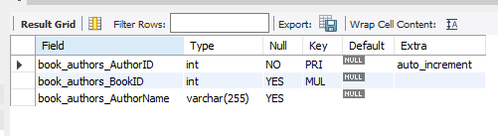
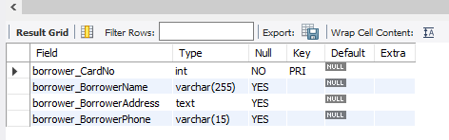
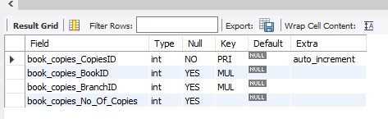
Publisher
Author
Copies
Borrower

Slide 6
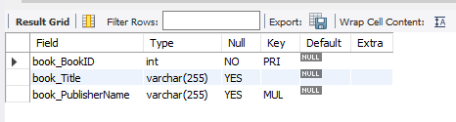
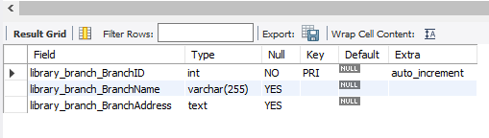
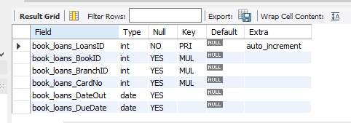
Book
Branch
Book Loans

Slide 7
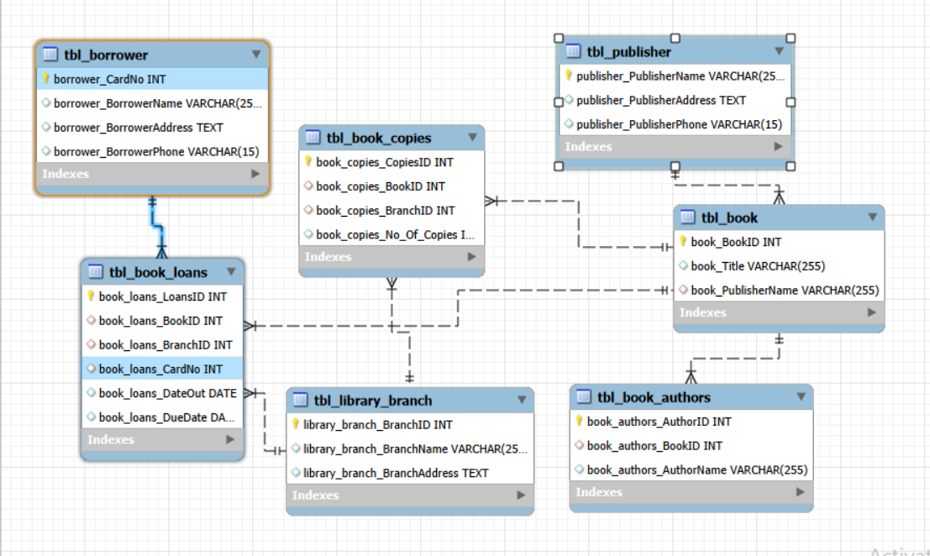
ER Diagram

Slide 8
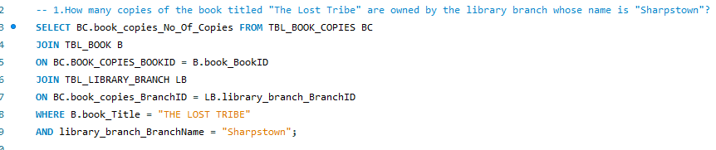

1.How many copies of the book titled "The Lost Tribe" are owned by the library branch whose name is "Sharpstown"?

Slide 9
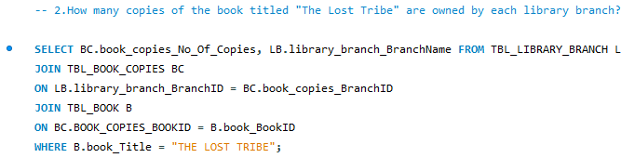
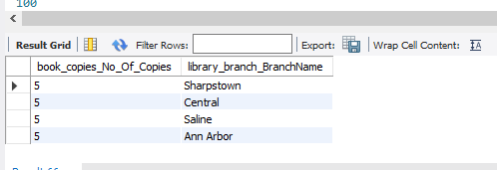
2.How many copies of the book titled "The Lost Tribe" are owned by each library branch?

Slide 10
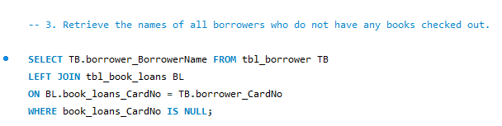
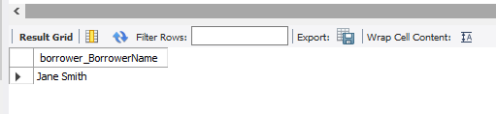
3.Retrieve the names of all borrowers who do not have any books checked out

Slide 11
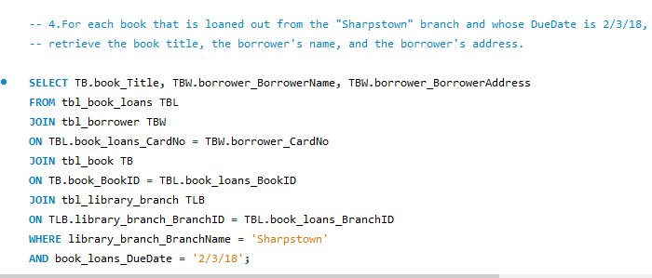
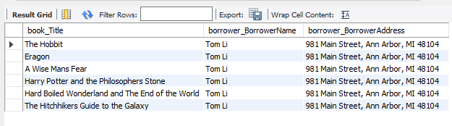
4.For each book that is loaned out from the "Sharpstown" branch and whose DueDate is 2/3/18, retrieve the book title, the borrower's name, and the borrower's address.

Slide 12
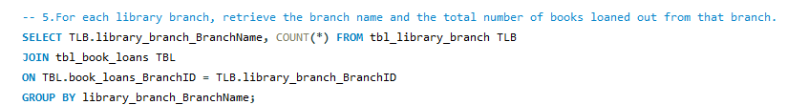
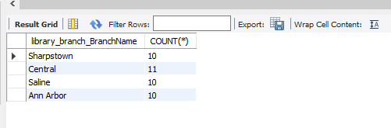
5.For each library branch, retrieve the branch name and the total number of books loaned out from that branch.

Slide 13
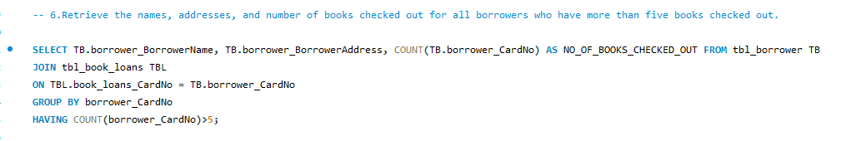
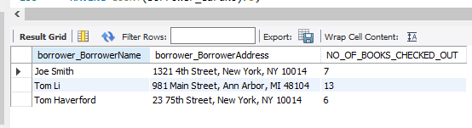
6.Retrieve the names, addresses, and number of books checked out for all borrowers who have more than five books checked out.

Slide 14
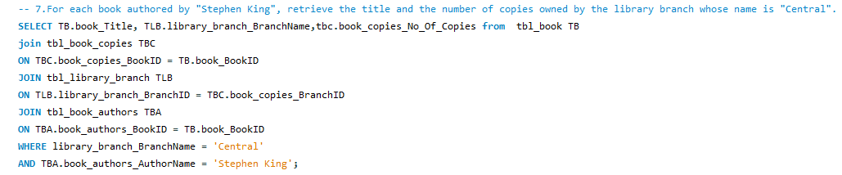

7.For each book authored by "Stephen King", retrieve the title and the number of copies owned by the library branch whose name is "Central".

Slide 15
Insights
This project helped us understand how to design a database and manage data effectively using SQL.
We learned how to create tables and connect them using relationships like primary keys and foreign keys.
We also gained experience in writing SQL queries to retrieve useful information from the database.
Overall, this project improved our logical thinking and showed the importance of structured data in real-world applications.

Slide 16
Challenges
While working on this project, we faced some difficulties in designing tables and establishing proper relationships.
Understanding primary keys and foreign keys was a bit confusing in the beginning.
We also encountered errors while writing SQL queries and had to debug them carefully.
However, by practicing and correcting mistakes, we were able to complete the project successfully.

Slide 17
CONCLUSION
In this project, we successfully created a Library Database using SQL. We designed tables and connected them properly using keys.
We also used SQL queries to get useful information such as book details, borrower details, and loan records. This project helped us understand how to manage and analyze data in a structured way.
Overall, this system makes library management easier, faster, and more accurate compared to manual methods.

Slide 18

THANK YOU

